Slide 1



ENGINEERING EXCELLENCE CENTER
ADVANCED GIT
2015, November

Slide 2
Agenda
5
Remote repositories
1
WHAT ENGX IS?
Git Tags
ENGX Programs
2
6
3
What is Git?
7
Branch, Merge, Rebase
Revert changes
4
8
How to organize development?

Slide 3
WHAT ENGX IS?
EPAM = ENGINEERING HEAVEN
Promote the best engineering practices, influence engineering culture and mindset to facilitate faster, better quality delivery and make EPAM the best place for the Engineering Talent.
FOR OUR ENGINEERS
Actively support and encourage EPAM engineering teams to improve their practices, setup, processes, and tools, code quality and control, be better engineers.
AND FOR OUR CLIENTS
Provide a world-class, sustainable consulting and SWAT “Engineering Excellence” services for EPAM clients. Stay connected with top ISVs to get the best, and give the best we can.
ENGINEERING
EXCELLENCE CENTER
Primary objective is to bring and propagate the best engineering practices, optimize processes, engineering setup and tools to facilitate faster and better quality delivery.

Slide 4

What is Git?

Slide 5
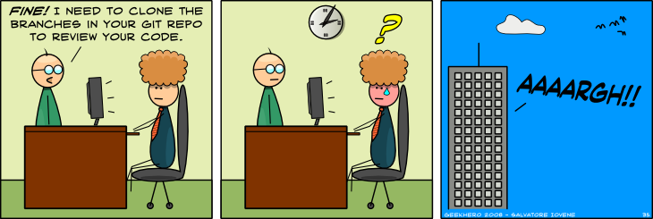
WHAT IS GIT?
Git:

Slide 6
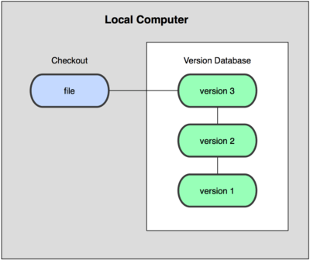
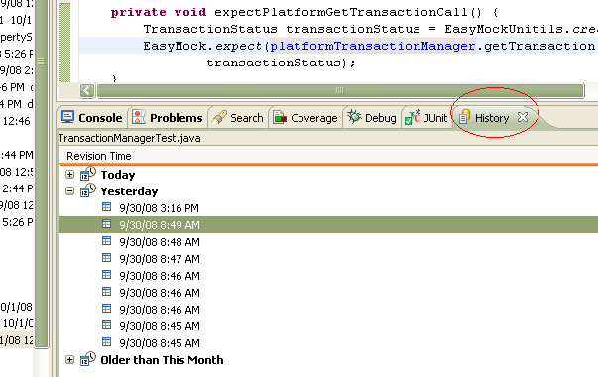
About version control
Local database

Slide 7

About version control
Centralized Version Control Systems

Slide 8
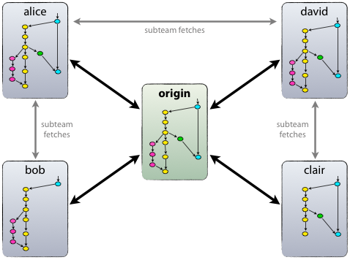
About version control
Distributed Version Control Systems

Slide 9

Short story of git
Linux
Before 2002 patch emailing system
BitKeeper between 2002 and 2005
git from April of 2005
git:
“I’m an egotistical bastard, and I name all my projects after myself. First Linux, now git.” – Linus

Slide 10
What is Git
distributed revision control and
source code management system
git != SVN + Magic
Stupid content tracker
Content-addressable
Snapshots
New tree
Blobs
Pointers
No diff! (like SVN)
„There may be a lot of things that Git is not good at, but these things are what Git is very good at.”

Slide 11
Under the hood

Slide 12
Object database
HEAD
master
commit
-lib
|-README
-source
|-example
| - example.html
-source.html
tree
tree
blob
tree
blob
blob

Slide 13
Object database
Git Object Database, which is kept in the Git Directory
Each object is compressed (with Zlib) and referenced by the SHA-1 value (40 chars) of its contents plus a small header.
Types
Blob
Tree
Commit
…

Slide 14
Object database
HEAD
master
commit
-lib
|-README
-source
|-example
| - example.html
-source.html
tree
tree
blob
tree
blob
blob

Slide 15
Object database
HEAD
master
commit
-lib
|-README
-source
|-example
| - example.html
-source.html
tree
tree
blob
tree
blob
blob

Slide 16
Object database
HEAD
master
commit
-lib
|-README
-source
|-example
| - example.html
-source.html
tree
tree
blob
tree
blob
blob

Slide 17
Object database
HEAD
master
commit
-lib
|-README
-source
|-example
| - example.html
-source.html
tree
tree
blob
tree
blob
blob

Slide 18
Object database
HEAD
master
commit
-lib
|-README
-source
|-example
| - example.html
-source.html
tree
tree
blob
tree
blob
blob

Slide 19
Object database
HEAD
master
commit
-lib
|-README
-source
|-example
| - example.html
-source.html
tree
tree
blob
tree
blob
blob

Slide 20
Object database
Let’s look how is working ☺
Let’s create the local repository?
git init

Slide 21
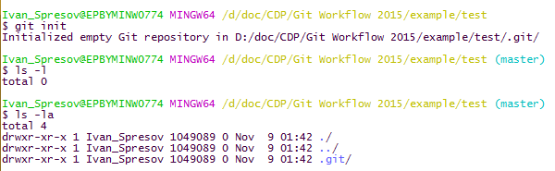
Object database

Slide 22
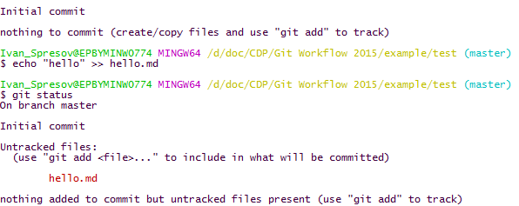
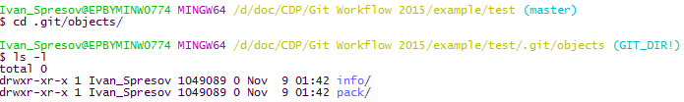
Object database

Slide 23
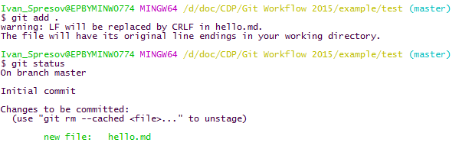
Object database

Slide 24
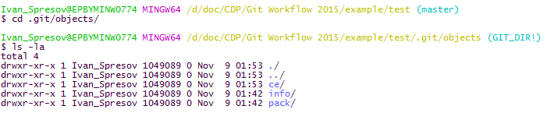
Object database

Slide 25
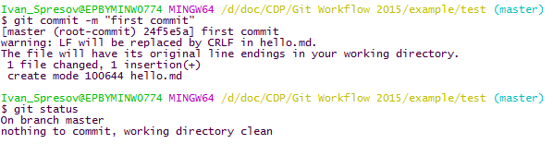
Object database

Slide 26
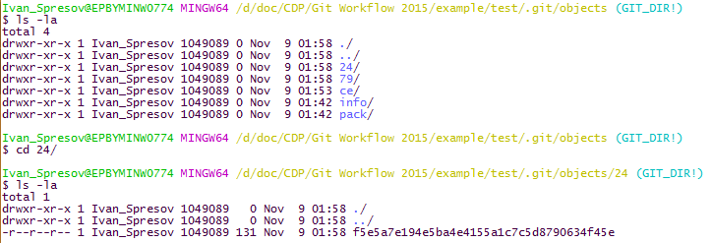
Object database

Slide 27
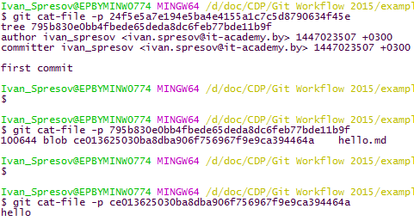
Object database

Slide 28
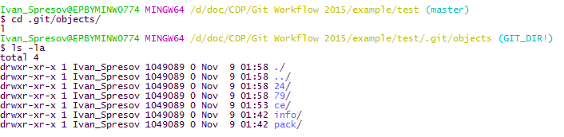
Object database

Slide 29
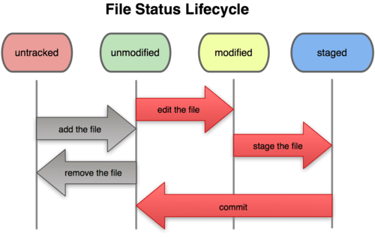
File status lifecycle

Slide 30

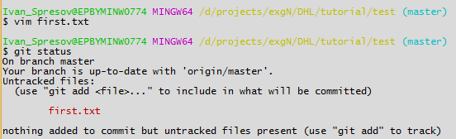
git status

Slide 31
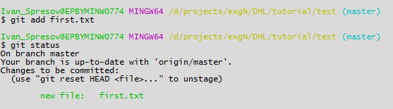
git add

Slide 32
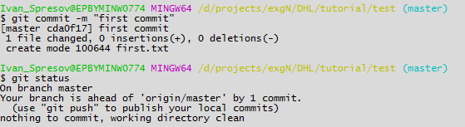
git commit

Slide 33
Object database
HEAD
master
-lib
|-README
-source
|-example
| - example.html
-source.html
commit
commit
tree
tree
tree
blob
tree
tree
blob
tree
$> modify example.html
$> git commit -a
blob
blob

Slide 34
Object database
HEAD
$> modify README
$> git commit -a
commit
master
test
commit
commit
commit
-lib
|-README
-source
|-example
| - example.html
-source.html
tree
tree
tree
tree
blob
tree
blob
tree
blob
tree
blob
blob

Slide 35
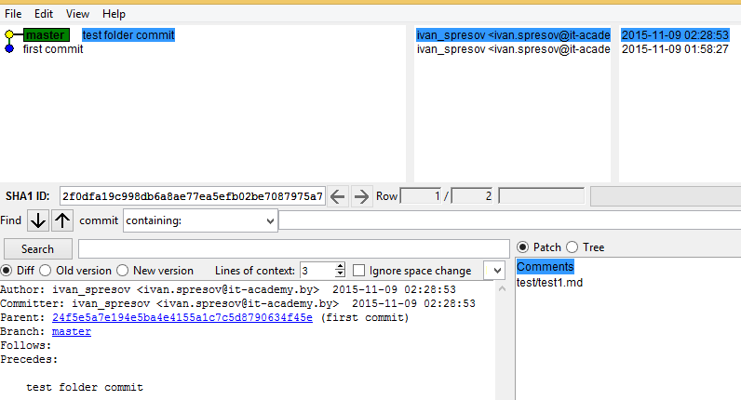
Object database

Slide 36


Object database

Slide 37
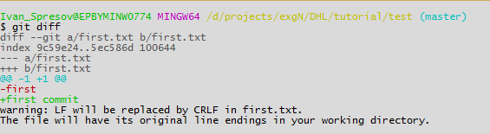
git diff

Slide 38
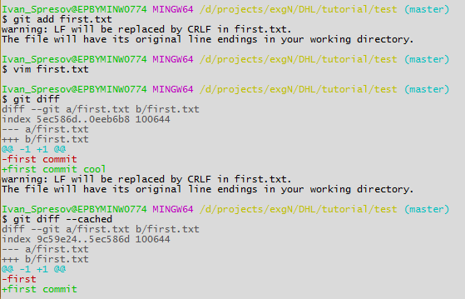
git diff and --cached

Slide 39
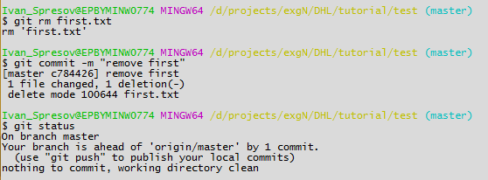
git rm

Slide 40
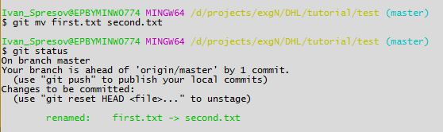
git mv

Slide 41
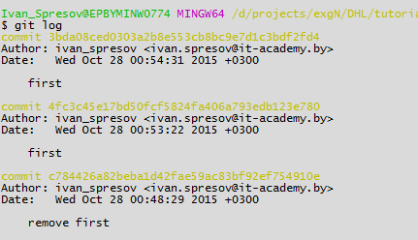
git log

Slide 42
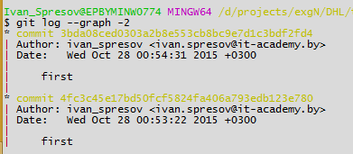
git log --graph

Slide 43
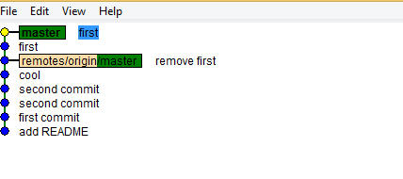
gitk | gitx

Slide 44
git reflog
Helps to see list of all changes done by git

Slide 45
Revert changes

Slide 46
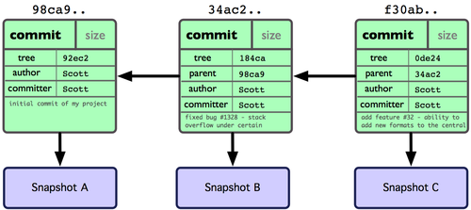
git commit --amend

Slide 47
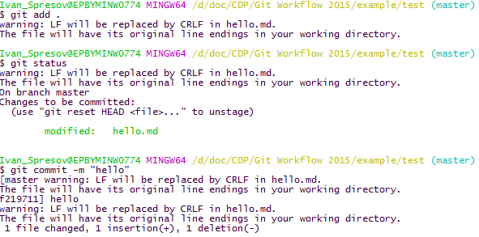
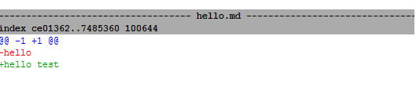
git commit --amend

Slide 48
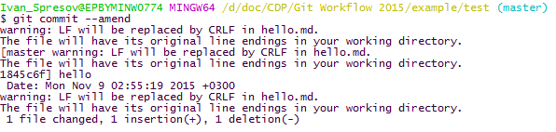

git commit --amend

Slide 49
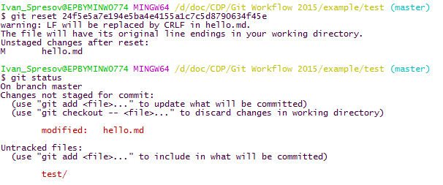
Git reset
git-reset - Reset current HEAD to the specified state

Slide 50
git checkout <sha1>
HEAD
master
develop
commit
commit
commit
tree
tree
tree
tree
blob
tree
blob
tree
blob
tree
blob
blob

Slide 51
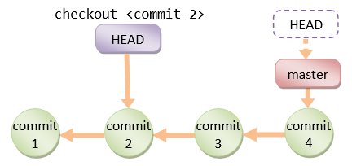
Detached head

Slide 52
Remote repositories

Slide 53
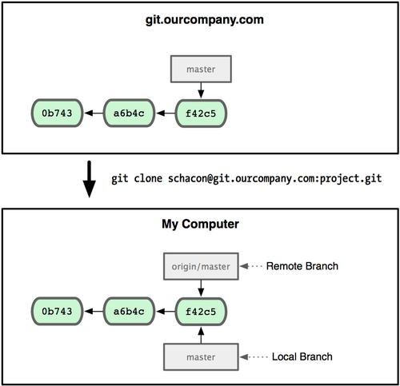

Git Remotes
Remote branches

Slide 54
Git Remotes
git remote add:
Remote branches are in .git/refs/remotes
Remote branches could be tracked by local branches
Remote branch can be fetched/rebased/merged
Local branch can be committed/pushed (rebased/merged to another local branch)
Remote branch can be checked out, but HEAD will be in detached state
You can commit to a detached HEAD, but it will be detached

Slide 55
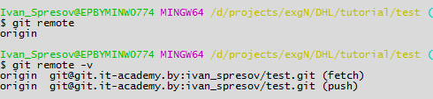
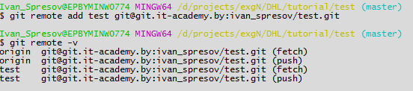
Git Remotes

Slide 56
Git on the Server
Web-based hosting services for software development projects that use the Git revision control system
Central repository
Collaboration
Issue tracking
Pull requests
Examples
github
bitbucket
Atlassian Stash
Gitlab (eg. git.epam.com)
…

Slide 57
Git on the Server
Protocols
Local
SSH – anonymous access not supported
git – own protocol, no authentication
http(s)

Slide 58
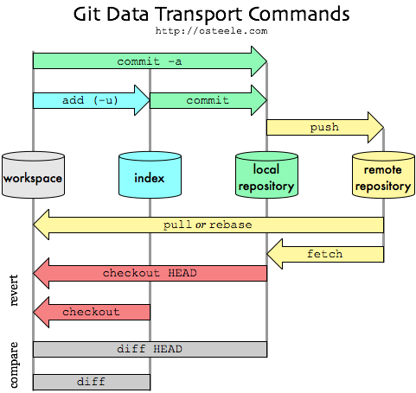
git fetch vs. pull

Slide 59

git fetch

Slide 60
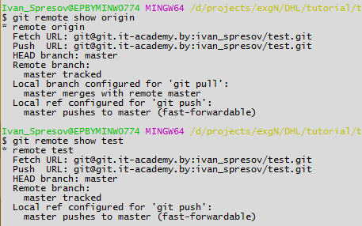
git remote show

Slide 61
Git Tags

Slide 62
Tagging
Tag specific points in the history
Types
Lightweight
Like a branch, but cannot be changed
Annotated
Object in the git database (name, e-mail, date)
Branch can be created from a tag
Commands
git tag [tag]
git tag –a [tag] –m message
git push [remote] [tagname]

Slide 63
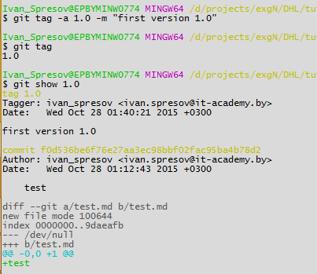
git annotated tag

Slide 64
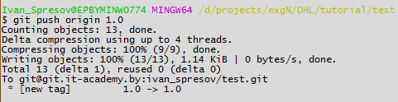
git tag

Slide 65
Branch, Merge, Rebase

Slide 66

Git Branching
What is a branch?
A branch is only a new pointer (40 bytes)
Commands
git branch
git checkout
git merge

Slide 67
Git Branching
Branch management
Long running branches
master: code that has been or will be released
develop (next): used to work from or test stability
Short-lived branches
topic: used for a single particular feature or related work

Slide 68
git checkout -b feature
master
С0
С1

Slide 69

git checkout -b feature
HEAD
master
feature1
С0
С1
$> git checkout -b feature1
$> git branch feature1
$> git checkout feature1

Slide 70

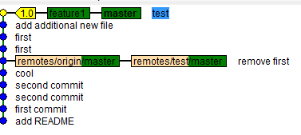
git branch feature1

Slide 71
Git branch
HEAD
master
feature
С0
С1
$> write code
$> git commit -a
$> write code
$> git commit -a

Slide 72

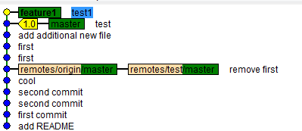
Git branch
HEAD
master
feature
С0
С1
С2
С3
$> write code
$> git commit -a
$> write code
$> git commit -a

Slide 73
Bug fix
HEAD
HOTFIX!
t1
master
$> git checkout master
$> fixing
$> write code
$> git commit -a
$> git tag t1
С0
С1
С4
С2
С3
feature
С2

Slide 74
Git branch
t1
master
С0
С1
С4
С2
С3
С5
feature
HEAD
$> git checkout feature
$> coding ...
$> git commit -a

Slide 75
Merge
t1
master
С0
С1
С4
С2
С3
С5
feature
HEAD
$> git checkout master
$> git merge feature

Slide 76
Merge (fast-forwarding)
HEAD
t1
master
С0
С1
С4
С6
С2
С3
С5
$> git checkout master
$> git merge feature
feature

Slide 77
Merge
$> write code
$> git commit -a
$> write code
$> git commit -a
HEAD
master
feature
С0
С1

Slide 78
Merge
HEAD
master
feature
С5
С0
С1
С2
С3
С4
$> git checkout master
$> git merge feature
git pull develop == git fetch && git merge/rebase

Slide 79
Merge
HEAD
master
С5
M1
С0
С1
С2
С3
С4
feature
$> git checkout master
$> git merge feature

Slide 80
Rebase
origin/master
$> furious coding …
$> commits
$> coding
$> commits
R1
R2
С0
C0:C1
С2
С3
С1
master

Slide 81
Rebase
origin/master
R1
R2
C1:C3
С0
R1:C2
C4
C5
С1
С2
С3
master
$> git rebase origin master

Slide 82
fetch and merge
fetch and merge
origin/master
R1
R2
С0
С1
С2
С3
С4
rebase
master
origin/master
С0
R1
R2
C4
C5
С1
С2
С3
master

Slide 83
How to organize
development?

Slide 84



Development: Option 1
Every commit directly to ‘dev’.
Every change can or can not break stability of ‘dev’.
Design on the fly.
Less conflicts.
More rework due to changes in common parts.
Nick
Nick
Alex
Alex
Nick
Nick
Alex
dev
Nick committed part of API
Nick reworked part of API because of issue.
Alex committed part of UI, no communication with backend.
Alex committed attempt to use part API without success.
Nick fixed issue with API
Nick implemented full API.
Alex finished UI.

Slide 85

Development: Option 2
Every change (usually subtask) is made directly to ‘dev’.
Every change do not break stability of ‘dev’.
Every change is guarded.
Needs more independent and well decomposed subtasks.
No design on the fly.
Less rework because of changed common code.
Nick
Nick
Alex
Nick
dev
API by Nick, review it’s good for both.
Mocked data returned by API, Nick, reviewed.
Commit 3 and 4 independently: UI by Alex, backend by Nick. If UI first - mocked data returned. If backend first, all in time.

Slide 86
Development: Option 3
Every change (usually subtask) is made to 'story’ branch.
Merge to ‘story’ branch is not guarded.
Merge to ‘dev’ branch is not guarded.
Design on-the-fly.
More branches to support.
Safe place for long and dangerous story development.
Nick
Alex
Nick
Alex
Nick
Alex
story
dev
Nick committed part of API
Alex committed part of UI, no communication with backend.
Nick, part of implementation of API.
Alex tried to use part API without success.
Nick fixed API.
Alex suported change.
Merge to dev, because they fill story is ready.

Slide 87
Development: Option 4
Every change (usually subtask) is made to 'story’ branch.
Merge to ‘story’ branch is not guarded.
Merge to ‘dev’ branch is guarded.
Needs more independent and well decomposed stories.
Design on-the-fly.
More branches to support.
Safe place for long and dangerous story development.
Nick
Alex
Nick
Alex
Nick
Alex
story
dev
Nick committed part of API
Alex committed part of UI, no communication with backend.
Nick, part of implementation of API.
Alex tried to use part API without success.
Nick fixed API.
Alex suported change.
Review and verification before merge.

Slide 88
Development: Option 5
Every change (usually subtask) is made to ‘feature’ branch.
Changes are guarded.
Merge to ‘dev’ branch is guarded.
Needs less independent and well decomposed subtasks.
Safe place for long and dangerous story development.
Nick
Nick
Alex
Nick
story
dev
Commit 1 - API by Nick, review it’s good for both.
Commit 2 - Mocked data returned by API, Nick, reviewed.
Commit 3 and 4 independently: UI by Alex, backend by Nick.

Slide 89
Baby Steps
http://epa.ms/git-puzzle

Slide 90
More about GIT
https://git-scm.com/book/en/v2
https://www.atlassian.com/git/tutorials/
http://pcottle.github.io/learnGitBranching/?NODEMO
https://www.codeschool.com/paths/git
https://try.github.io/levels/1/challenges/4
http://think-like-a-git.net/
https://kb.epam.com/display/DHLEWF/Gerrit+Set+Up

Slide 91

Ask your questions
Feel free to

